Slide 1
INF10025
Data Management and Analytics
Lecture 9 – Part 1
Multi-Valued Attributes
Characteristic Entities
ERD Case Studies
Views
Visio

Slide 2
Multi-Valued Attributes
An ERDs may contain a multi-valued attribute (MVA)
  An MVA is an attribute surrounded by {braces}.
A multi-valued attribute is used when an attribute may
have more than one value for an entity instance.
  Eg. An Employee might have multiple skills etc.
  Example: Skill is a multi-valued attribute of EMPLOYEE
  Employee 15, Joe may have the following Skills:
      'Forklift Driver'
      'Crane Operator'
      'Welder'

Slide 3
Multi-Valued Attributes
A multi-valued attribute, is a shortcut way of representing the fact that an Employee may have many Skills.
Below is an example of the same ERD after expanding the MVAs.
And we know that a M:M relationship must be converted if converting to a relational schema

Slide 4
Characteristic Entity
In this example the Skill entity is called a Characteristic Entity.
Characteristic Entity:
A Strong Entity with only key (identifier)
attributes

Slide 5
Characteristic Entity
Some texts suggest that characteristic entities should be eliminated from an ERD.
After all, why bother with a separate table named Skill, when the data in the intersection entity already contains ALL the data stored in a single row of Skill data? The Skill table does not add any new data to the database.
EmpNo | SkillName
15 | Welder
17 | Electrician
17 | Welder
SkillName
Electrician
Welder

Slide 6
Characteristic Entity
When building a database, a table based on a characteristic entity is useful.
The values in the Skill table are used as a foreign key constraint.
  The foreign key constraint will force every SkillName value in the EmpSkill table to match a Primary Key value in the referenced Table.
    EMPLOYEE (EmpNo, EmpName)
    PK (EmpNo)
    SKILL (SkillName)
    PK (SkillName)
    EMPSKILL (EmpNo, SkillName)
    PK (EmpNo, SkillName)
    FK (EmpNo) References EMPLOYEE
    FK (SkillName) References SKILL

Slide 7
Characteristic Entity
Example: Using the Characteristic entity to force referential integrity
EMPSKILL (EmpNo, SkillName)
    PK (EmpNo, SkillName)
    FK (EmpNo) References EMPLOYEE
    FK (SkillName) References SKILL
Insert Into EmpSkill (EmpNo, SkillName) Values (15, "Electrician");
This statement is OK. The data is inserted.
Insert Into EmpSkill (EmpNo, SkillName) Values (15, "Plumber");
This statement fails. Referential Integrity Error or Foreign Key
constraint error. "Plumber" is not a PK of Skill.
EmpNo | EmpName
15 | Jim
17 | Frank
19 | Peter
EmpNo | SkillName
15 | Welder
17 | Electrician
17 | Welder
SkillName
Electrician
Welder

Slide 8
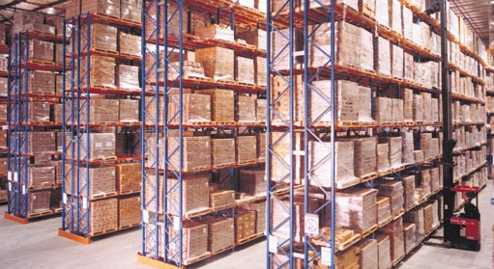
Words and meanings
What is a class?
  Is that the same as a tutorial?
  Is it the same as a lab?
  Many staff / students use these terms interchangeably
  (no disadvantage in using the wrong term).
  However, within the Swinburne HR they have very different meanings
  In the Payroll system, staff involved in these activities get paid at different rates!
If you are unsure on the meaning of a word or phrase – then ask
There is no such thing as a dumb question
  War Story
  Pallets
  Streets / Aisles
  Bays / Slots / Locations

Slide 9
Pizza Online
Case Study 1

Slide 10
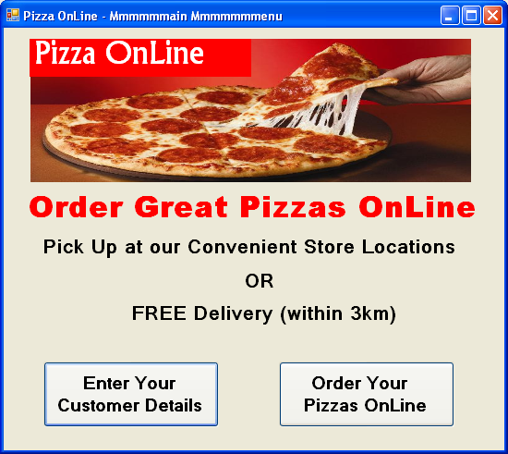
Case Study - Overview
Let's consider a different business called Pizza OnLine
  It allows customers to order Pizzas via the WWW.
  Customers have pizzas delivered.
  Only people who register with a credit card number can be a an on-line customer.

Slide 11
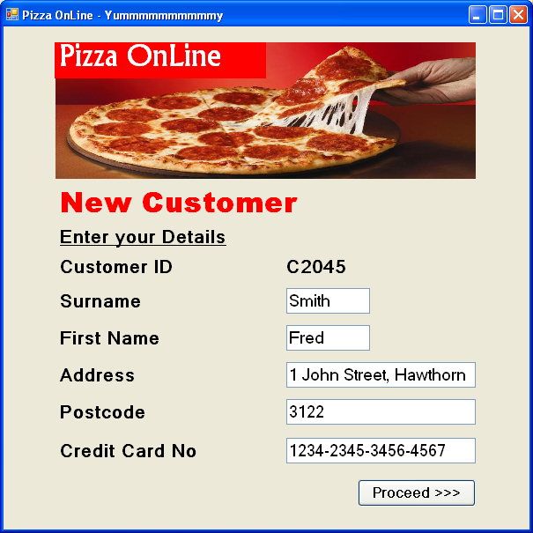
Case Study - Customer Details
Customers need to supply personal details:
  Name
  Address
  Credit Card No

Slide 12
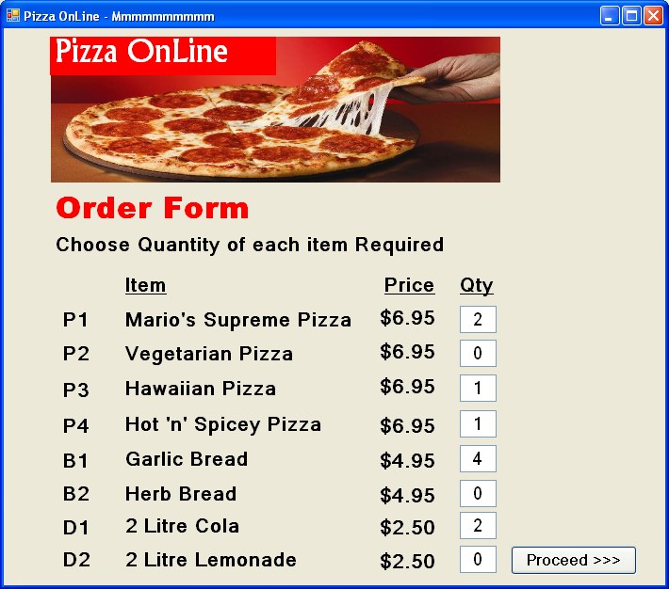
Case Study – Order Details
The Order Form.
  This is One Order.
  The customer may add multiple items & different quantities

Slide 13
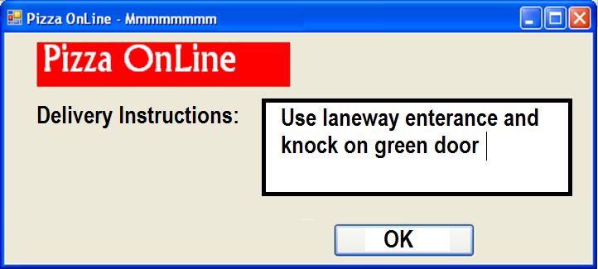

Case Study - Customer Details
Add any delivery instructions that are required for the order:

Slide 14
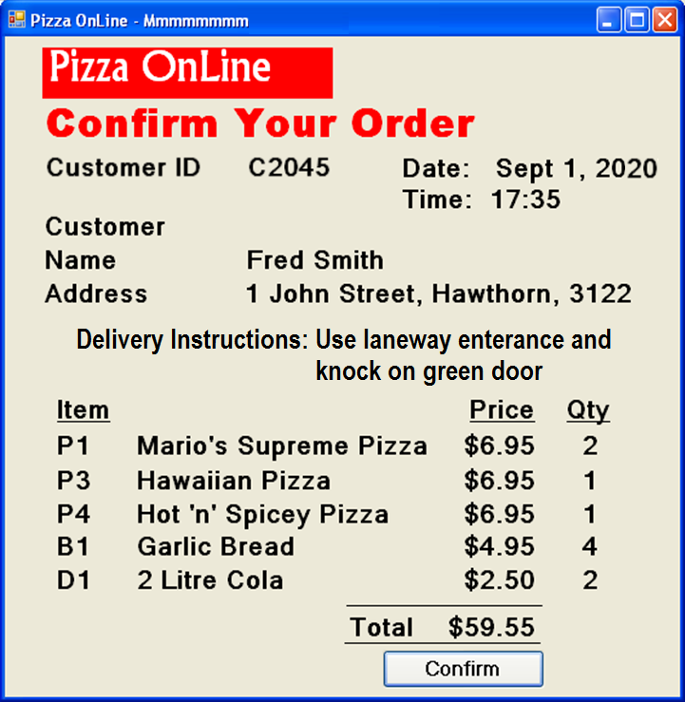


Case Study – The completed Order
This Order is for
Customer C2045.
Order Date & Time is
Sept 1, 2020 17:35
This order has special
delivery instructions
The order is for many
different Items.
Each item ordered
has a Quantity value

Slide 15
Case Study – ERD
One order must have One customer.
One customer may make Many orders.
One order may refer to Many items
One item may be referenced by Many orders

Slide 16
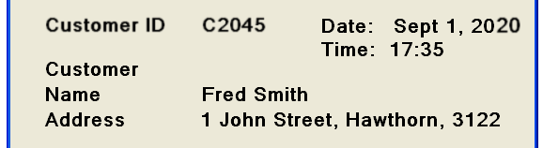
Case Study – Order Key
What is the primary key of Order?
  CustID and DateTime
    Each business/organisation is different
      Some businesses would use OrderNumber instead
      Warning:
      If OrderNumber is mentioned in the narrative then OK
      If OrderNumber is not mentioned in the narrative then NO

Slide 17
Where to place the Quantity attribute
We need to place the Quantity attribute on the ERD
  It doesn't belong to Item
    It would mean an item always has the same quantity. Silly
  It doesn't belong to Order
    It would mean a cust orders the same quantity of each item. Silly
Quantity must be attached to the M:M relationship

Slide 18
Pizza Online M:M
Again we have a M:M relationship
The M:M must be expanded
We create a diagram with an entity called OrderLine.
One order has MANY orderliness.
Each orderline belongs to one order.
Each orderline refers to one item.

Slide 19
Pizza Online relational schema
  ORDER( CustId, DateTime, DeliveryInstructions)
    PK: (CustId, DateTime)
    FK: (CustId) references CUSTOMER
  ORDERLINE( CustId, DateTime, ItemCode, Quantity)
    PK: (CustId, DateTime, ItemCode)
    FK1: (CustId, DateTime) references ORDER
    FK2: (ItemCode) references ITEM
This diagram pattern is seen many times in business.
A patron makes a loan from a library. The loan has many loan-lines.
A store sends an invoice to a customer. The invoice has many invoice lines.

Slide 20
Pizza Online data
  Example of data for Order and OrderLine
      CustId DateTime Delivery Instructions
      C2045 1 Sept 2020, 17:35 Use laneway entrance
      CustId DateTime ItemNo Quantity
      C2045 1 Sept 2020, 17:35 P1 2
      C2045 1 Sept 2020, 17:35 P3 1
      C2045 1 Sept 2020, 17:35 P4 1
      C2045 1 Sept 2020, 17:35 B1 4
      C2045 1 Sept 2020, 17:35 D1 2
ORDER
ORDERLINE

Slide 21
Review: Weak Entity is central to solution
What is the purpose of the pizza online system?
  To allow customers to order many items at a time
  To keep a history of orders that show who has ordered what
  The key entity in this ERD is the OrderLine weak entity

Slide 22
Review: Can't Order & Orderline be merged?
Many students ask if Order and OrderLine should be merged.
Answer: No.
If merged every orderline would contain the delivery instructions
  Causing redundancy and potential update anomaly
If the delivery instructions changed, then every row of the order would need to be updated.
      CustId DateTime ItemNo DeliveryInstructions Quantity
      C2045 1 Sept 2020, 17:35 P1 Use laneway entrance and … 2
      C2045 1 Sept 2020, 17:35 P3 Use laneway entrance and … 1
      C2045 1 Sept 2020, 17:35 P4 Use laneway entrance and … 1
      C2045 1 Sept 2020, 17:35 B1 Use laneway entrance and … 4
      C2045 1 Sept 2020, 17:35 D1 Use laneway entrance and … 2

Slide 23
Can we use OrderNumber as a Primary Key?
Within the ERD Model and Relational Model the Order is identified by
the CustID and DateTime. These are real world attributes.
  Do not include an attribute called OrderNo.
  OrderNo has no real world meaning.
When you actually come to build the database, then you may choose to introduce a surrogate key such as OrderNo.
Obviously, if the business already uses order numbers, then OrderNo is a real world attribute and can be used within the ERD and Relational model.

Slide 24
Glenferrie Toy Library
Case Study 2

Slide 25
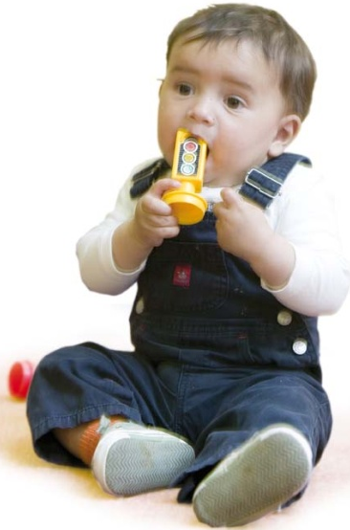
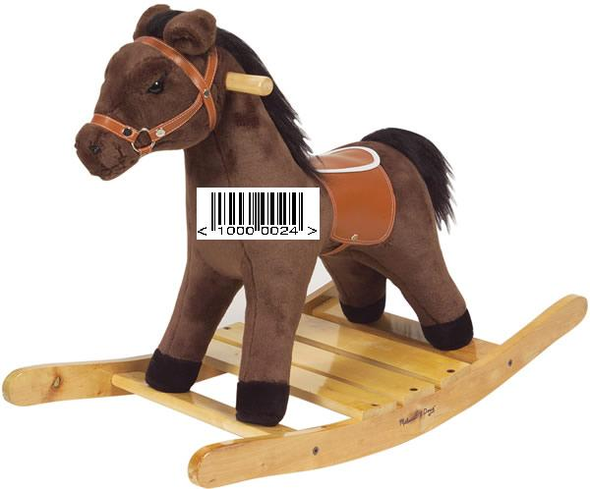


Glenferrie Toy Library System
Let's re-examine the Glenferrie Toy Library.
Previously each loan was for one item only
That requirement has changed.
  One loan may refer to many different items
  Need to record which library person conducted the loan process
Glenferrie Toy Library
Patron ID Card
Patron No: 12345678

Slide 26
Toy Library ERD modified
What changes are required ?
  The relationship for Loan and Toy becomes a M:M relationship
  The library staff member name is stored in the Loan entity

Slide 27
Toy Library ERD modified
The M:M relationship is expanded to reveal a weak entity
  The name of the weak entity is usually named something like
    LineItem (similar to OrderLine from the Pizza caser study)

Slide 28
DateTime Returned
Suppose that we want to include a DateTime Returned value
  For each toy as it is returned
  Toys may be returned on different days
  In which entity does DateTime Returned belong?

Slide 29
DateTime Returned
If DateTimeReturned is added to Loan, it means that
  All items for that loan must all be returned on the same date
    X Items may be returned on different days
    X Some items may not be returned at all

Slide 30
DateTime Returned
If DateTimeReturned is added to LineItem, it means that
  Each item may be returned on a different date

